Slide 1
Security sensing device msp 430
David Shabo
Ronnie Rozo

Slide 3
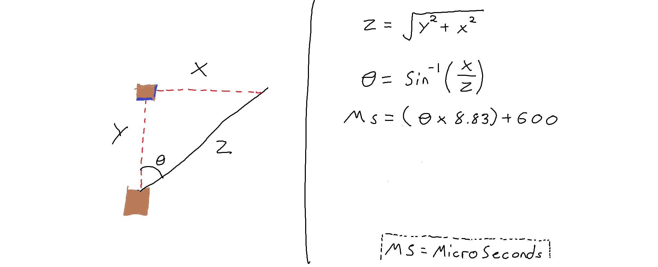

Slide 4
